Slide 1
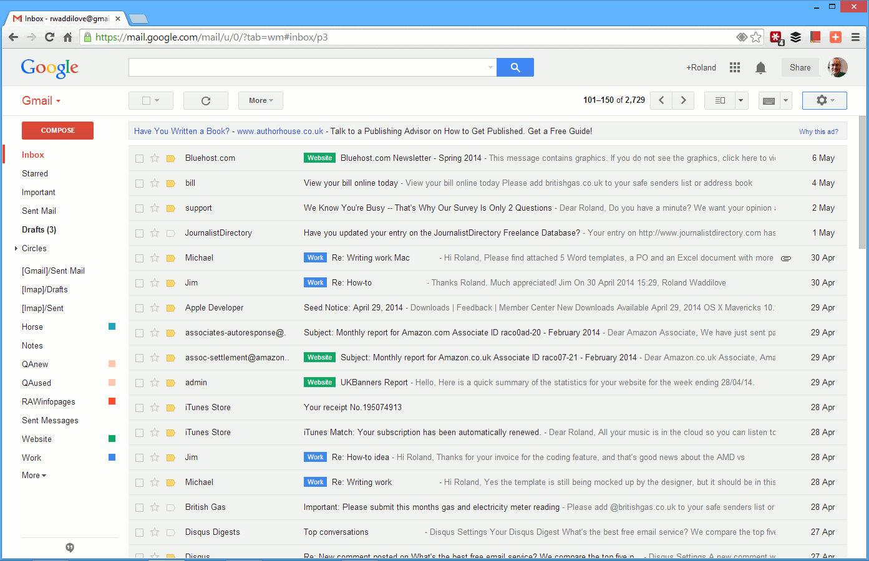
Extracting email contents and storing in a sql and nosql Databases

Slide 2
A company receives thousands or maybe more mails every single day and it can become very difficult to interpret and store the contents and attachments in them.
The program automatically goes through the contents (names, dates, invoice numbers etc.) and the attachments and store them in databases making it convenient for us as and when the mails are received( irrespective of whether they are marked as read or not)
This solution works for a specific format of mail and the senders addresses. However it can be implemented to work on a variety of other formats as well.
File attachments sent by different senders can also be stored and kept track of.

